Slide 1

CS7302 Big Data Analytics
Module 1
Course Instructor
Dr. S. Pitchumani Angayarkanni
Professor

Slide 2
Content Outline
Introduction to Big Data Analytics.
Introduction to Apache Hadoop and MapReduce
Apache Spark
Spark programming. (Python and PySpark)
Spark - Resilient Distributed Dataset (RDDs)

Slide 3
1.1 Introduction to Big Data Analytics

Slide 4
What is Big Data?
As Gartner defines it –“Big Data are high volume, high velocity, or high-variety information assets that require new forms of processing to enable enhanced decision making, insight discovery, and process optimization.”
The term ‘big data’ is self-explanatory −a collection of huge data sets that normal computing techniques cannot process.
The term not only refers to the data, but also to the various frameworks, tools, and techniques involved.
Technological advancement and the advent of new channels of communication (like social networking) and new, stronger devices have presented a challenge to industry players in the sense that they have to find other ways to handle the data.
Big data is an all-inclusive term, representing the enormous volume of complex data sets that companies and governments generate in the present-day digital environment.
Big data, typically measured in petabytes or terabytes, materializes from three major sources— transactional data, machine data, and social data.

Slide 5
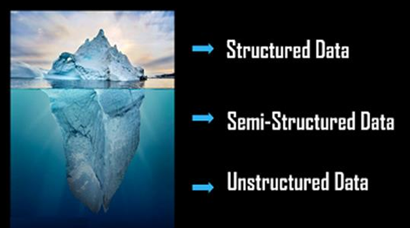
TYPES OF BIG-DATA
Big Data is generally categorized into three different varieties.
They are as shown below:
Structured Data
Semi-Structured Data
Unstructured Data

Slide 6
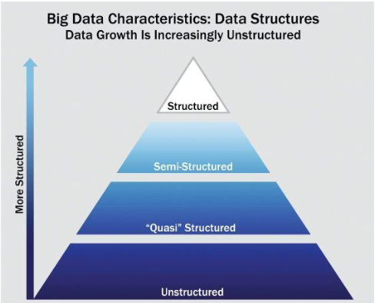

Slide 7
Structured Data
Structured Data owns a dedicated data model.
It has a well-defined structure.
Any data that can be processed, is easily accessible, and can be stored in a fixed format is called structured data.
In Big Data, structured data is the easiest to work with because it has highly coordinated measurements that are defined by setting parameters.
Structured types of Big Data are:-
Address
Age
Credit/debit card numbers
Contact
Expenses
Billing
Example Database Management

Slide 8
Defined as the data that has a defined repeating pattern
This pattern makes it easier for any program to sort, read and process the data
Processing structured data is much easier and faster than processing data without any specific repeating patterns
Features:
It is organized data in a predefined format
Is sorted in tabular form
Is the data that resides in fixed fields within record or file
Is formatted data that has entities and their attributes mapped
Is used to query and report against predetermined data types

Slide 9
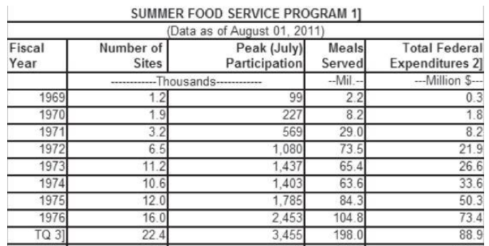
Data containing a defined data type, format, and structure (that is, transaction data, online analytical processing [OLAP] data cubes, traditional RDBMS, CSV files, and even simple spreadsheets).

Slide 10
Semi Structured Data
Semi-Structured Data can be considered as another form of Structured Data.
It inherits a few properties of Structured Data, but the major part of this kind of data fails to have a definite structure and also, it does not obey the formal structure of data models such as an RDBMS.
Also known as having a schema-less or self describing structure refers to a form of structured data that contains tags or markup elements in order to separate elements and generate hierarchies of records and fields in the given data.
Such type of data does not follow the proper structure of data models as in relational databases
Data is stored inconsistently in rows and columns of a database
Some sources for semi-structured data includes:
File systems such as Web Data in the form of cookies
Data exchange formats such as JavaScript Object Notation(JSON) data
Textual data files with a discernible pattern that enables parsing (such as Extensible Markup Language [XML] data files that are self-describing and defined by an XML schema)
Example: Comma Separated Values(CSV) File, XML data files

Slide 11
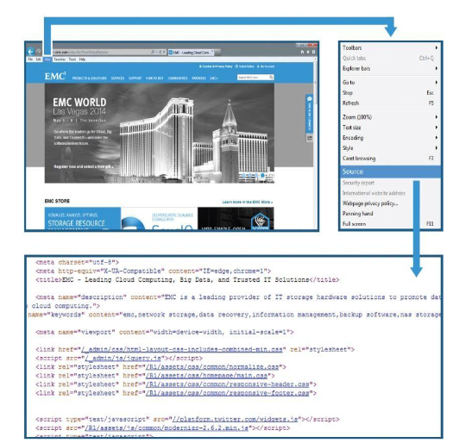

Slide 12
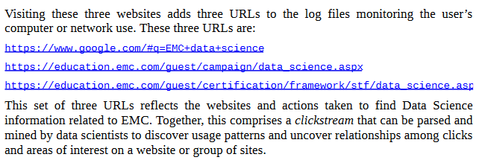
Quasi Structured Data
Textual data with erratic data formats that can be formatted with effort, tools, and time (for instance, web clickstream data that may contain inconsistencies in data values and formats).
Quasi-structured data is a common phenomenon that bears closer scrutiny

Slide 13
Unstructured Data
It is completely a different type of which neither has a structure nor obeys to follow the formal structural rules of data models.
It does not even have a consistent format and it found to be varying all the time.
But, rarely it may have information related to data and time.
Example: Audio Files, Images, PDF etc.

Slide 14
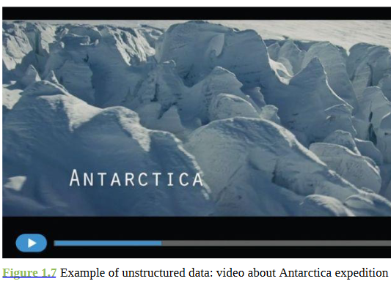

Slide 15
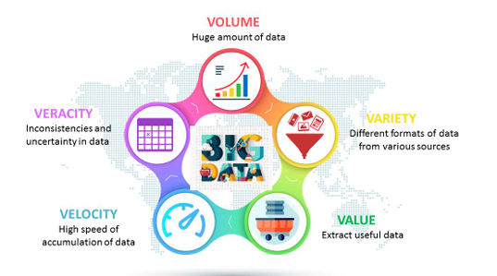
THE CHARACTERISTICS OF BIG DATA

Slide 16
Volume
Volume refers to the unimaginable amounts of information generated every second from social media, cell phones, cars, credit cards, M2Msensors, images, video, etc..
We are currently using distributed systems, to store data in several locations and brought together by a software Framework like Hadoop.
Facebook alone can generate about billion messages, 4.5 billion times that the “like” button is recorded, and over 350 million new posts are uploaded each day.
Such a huge amount of data can only be handled by Big Data Technologies

Slide 17
Is the amount of data generated by the organizations or individuals.
Today the volume of data in most organizations is approaching exabytes.
Some experts predict the volume of data to reach zettabytes in the coming years.
Organizations are doing their best to handle this ever-increasing volume of data.
For example, according to IBM over 2.7 zetabytes of data is present in the digital universe today.
Every minute over 571 new websites are being created.
IDC estimates that by 2020, online business transactions will reach up to 450 billion per day.

Slide 18
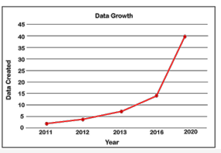

Slide 19
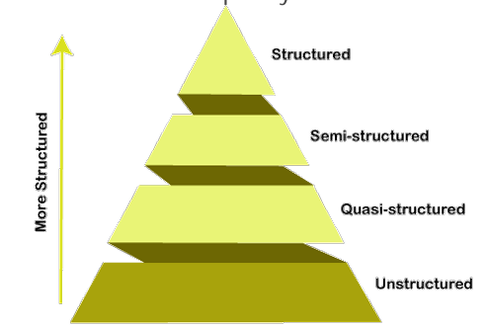
Variety
Big Data is generated in multiple varieties.
Compared to the traditional data like phone numbers and addresses, the latest trend of data is in the form of photos, videos, and audios and many more, making about 80% of the data to be completely unstructured.
Even a single source can generate data in varied formats for example, GPS and Social networking sites such as facebook , produce data all types, including text, images, videos etc.

Slide 20
Veracity
Veracity basically means the degree of reliability that the data has to offer.
Veracity generally refers to the uncertainty of data ie) whether the obtained data is correct or consistent
Out of the huge amount of data that is generated in almost every process, only the data that is correct and consistent can be used for further analysis
Data when processed becomes information, however a lot of effort goes in processing the data
Big data, especially in the unstructured and semi-structured forms is messy in nature and it takes a good amount of time and expertise to clean that data and make it suitable for analysis
Since a major part of the data is unstructured and irrelevant, Big Data needs to find an alternate way to filter them or to translate them out as the data is crucial in business developments

Slide 21
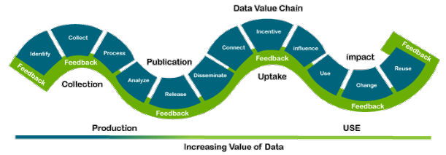
Value
Value is the major issue that we need to concentrate on. It is not just the amount of data that we store or process.
It is actually the amount of valuable, reliable and trustworthy data that needs to be stored, processed, analysed to find insights.

Slide 22
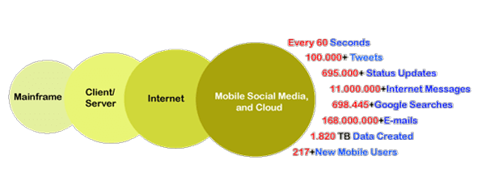
Velocity
Last but never least, Velocity plays a major role compared to the others, there is no point in investing so much to end up waiting for the data. So, the major aspect of Big Data is to provide data on demand and at a faster pace.

Slide 23
Velocity describes the rate at which data is generated, captured and shared
Enterprises can capitalize on data only if it is captured and shared in real time
Information Processing systems such as CRM and ERP face problems associates with data, which keeps adding up but cannot be processed quickly
These systems are able to attend data in batches every few hours; however this time lag causes the data to lose its importance as new data is constantly being generated
For example, eBay analyzes around 5 million transactions per day in real time to detect and prevent frauds arising from the use of PayPal
Portable device, including mobile, PDA etc. also generate data at a high speed

Slide 24
The sources of high velocity data includes the following:
IT devices, including routers, switches, firewalls etc. constantly generate valuable data
Social media, including facebook posts, tweets and other social media activities, cerate huge amount of data , which is to be analyzed instantly at a fast speed because the value degrades quickly with time

Slide 25
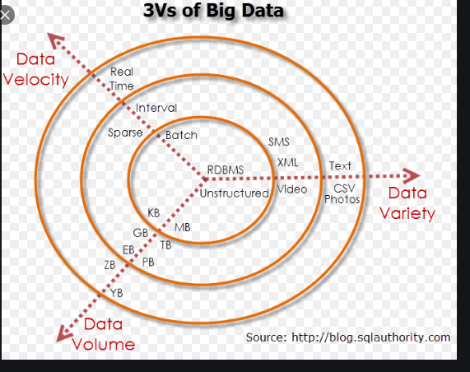

Slide 26
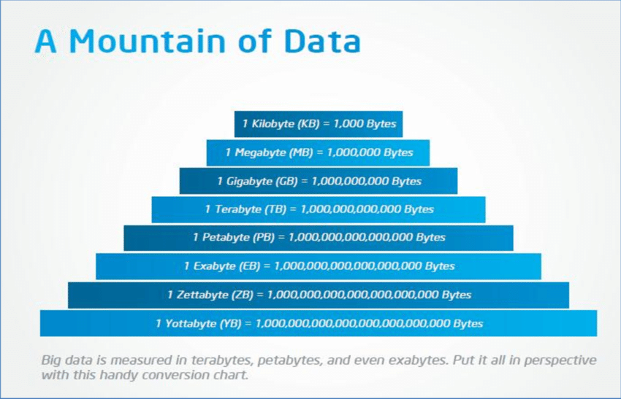

Slide 27
APPLICATIONS OF BIG DATA
Retail
Leading online retail platforms are wholeheartedly deploying big data throughout a customer’s purchase journey, to predict trends, forecast demands, optimize pricing, and identify customer behavioral patterns.
Big data is helping retailers implement clear strategies that minimize risk and maximize profit.
Healthcare
Big data is revolutionizing the healthcare industry, especially the way medical professionals in the past diagnosed and treated diseases.
In recent times, effective analysis and processing of big data by machine learning algorithms provide significant advantages for the evaluation and assimilation of complex clinical data, which prevent deaths and improve the quality of life by enabling healthcare workers to detect early warning signs and symptoms.

Slide 28
Financial Services and Insurance
The increased ability to analyze and process big data is dramatically impacting the financial services, banking, and insurance landscape.
In addition to using big data for swift detection of fraudulent transactions, lowering risks, and supercharging marketing efforts, few companies are taking the applications to the next levels.
Manufacturing
Advancements in robotics and automation technologies, modern-day manufacturers are becoming more and more data focused, heavily investing in automated factories that exploit big data to streamline production and lower operational costs.
Top global manufacturers are also integrating sensors into their products, capturing big data to provide valuable insights on product performance and its usage.

Slide 29
Energy
To combat the rising costs of oil extraction and exploration difficulties because of economic and political turmoil, the energy industry is turning toward data-driven solutions to increase profitability.
Big data is optimizing every process while cutting down energy waste from drilling to exploring new reserves, production, and distribution.
Logistics & Transportation
State-of-the-art warehouses use digital cameras to capture stock level data, which, when fed into ML algorithms, facilitates intelligent inventory management with prediction capabilities that indicate when restocking is required.
In the transportation industry, leading transport companies now promote the collection and analysis of vehicle telematics data, using big data to optimize routes, driving behavior, and maintenance.

Slide 30
Government
Cities worldwide are undergoing large-scale transformations to become “smart”, through the use of data collected from various Internet of Things (IoT) sensors.
Governments are leveraging this big data to ensure good governance via the efficient management of resources and assets, which increases urban mobility, improves solid waste management, and facilitates better delivery of public utility services.

Slide 31
Introduction to Apache Hadoop and MapReduce

Slide 32
What is Apache Hadoop?
Apache Hadoop is an open source software framework for storage and large scale processing of data-sets on clusters of commodity hardware.
Hadoop is an Apache top-level project being built and used by a global community of contributors and users.
It is licensed under the Apache License 2.0.
Hadoop was created by Doug Cutting and Mike Cafarella in 2005.
It was originally developed to support distribution for the Nutch search engine project.

Slide 33
Apache Hadoop framework
It has following modules:
Hadoop Common: contains libraries and utilities needed by other Hadoop modules
Hadoop Distributed File System (HDFS): a distributed file-system that stores data on the commodity machines, providing very high aggregate bandwidth across the cluster
Hadoop YARN: a resource-management platform responsible for managing compute resources in clusters and using them for scheduling of users' applications
Hadoop MapReduce: a programming model for large scale data processing

Slide 34
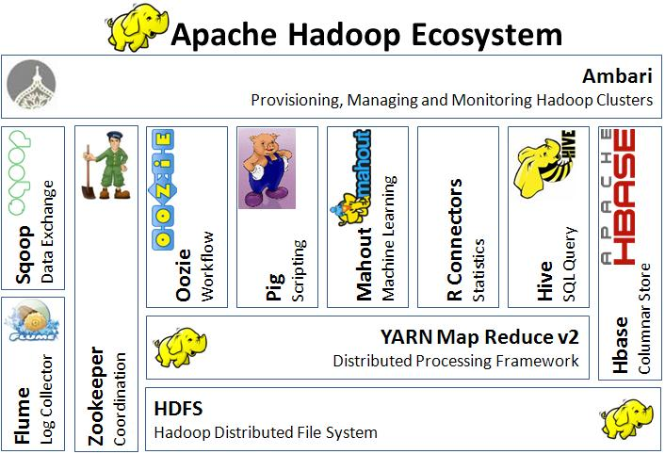

Slide 35
Hadoop has a large ecosystem of open source tools that can augment and extend the capabilities of the core module. Some of the main software tools used with Hadoop include:
Apache Hive: A data warehouse that allows programmers to work with data in HDFS using a query language called HiveQL, which is similar to SQL
Apache HBase: An open source non-relational distributed database often paired with Hadoop
Apache Pig: A tool used as an abstraction layer over MapReduce to analyze large sets of data and enables functions like filter, sort, load, and join
Apache Impala: Open source, massively parallel processing SQL query engine often used with Hadoop
Apache Sqoop: A command-line interface application for efficiently transferring bulk data between relational databases and Hadoop
Apache ZooKeeper: An open source server that enables reliable distributed coordination in Hadoop; a service for, "maintaining configuration information, naming, providing distributed synchronization, and providing group services"
Apache Oozie: A workflow scheduler for Hadoop jobs

Slide 36
For the end-users, though MapReduce Java code is common, any programming language can be used with "Hadoop Streaming" to implement the "map" and "reduce" parts of the user's program.
Apache Pig and Apache Hive, among other related projects, expose higher level user interfaces like Pig latin and a SQL variant respectively.
The Hadoop framework itself is mostly written in the Java programming language, with some native code in C and command line utilities written as shell-scripts

Slide 37
HDFS and MapReduce
There are two primary components at the core of Apache Hadoop 1.x: the Hadoop Distributed File System (HDFS) and the MapReduce parallel processing framework.
These are both open source projects, inspired by technologies created inside Google.

Slide 38
Key Components of Hadoop
Hadoop Distributed File System (HDFS): A distributed file system that provides high-throughput access to application data. It is designed to store large files across multiple machines in a fault-tolerant manner.
MapReduce: A programming model and software framework for writing applications that can process large amounts of data in parallel on large clusters of commodity hardware in a reliable, fault-tolerant manner.

Slide 39
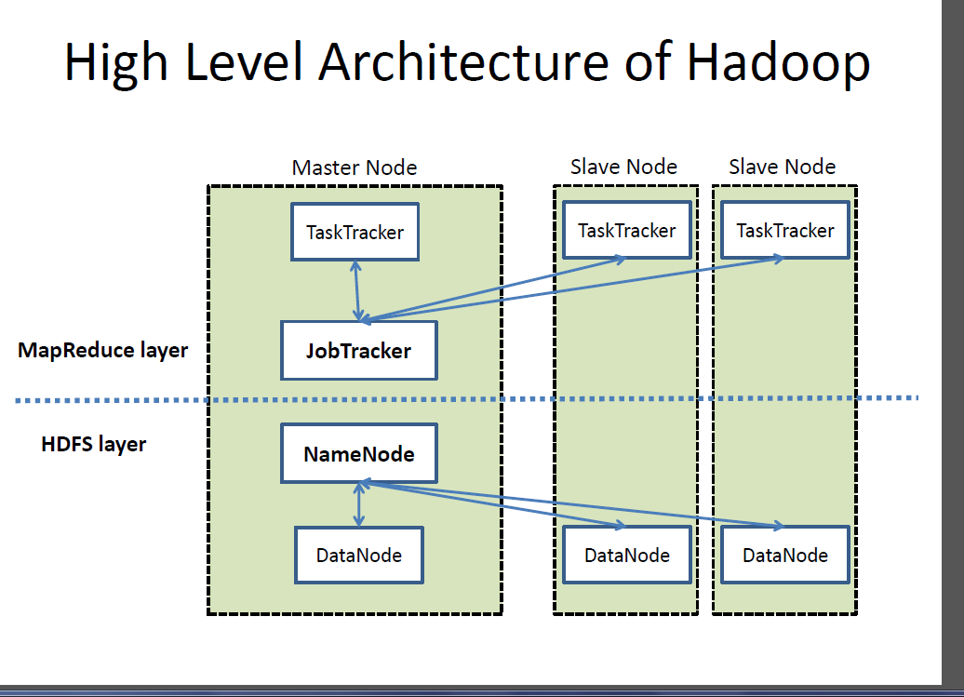

Slide 40
Hadoop distributed file system
The Hadoop distributed file system (HDFS) is a distributed, scalable, and portable file-system written in Java for the Hadoop framework.
Each node in a Hadoop instance typically has a single namenode, and a cluster of datanodes form the HDFS cluster.
The situation is typical because each node does not require a datanode to be present.
Each datanode serves up blocks of data over the network using a block protocol specific to HDFS.
The file system uses the TCP/IP layer for communication.
Clients use Remote procedure call (RPC) to communicate between each other.

Slide 41
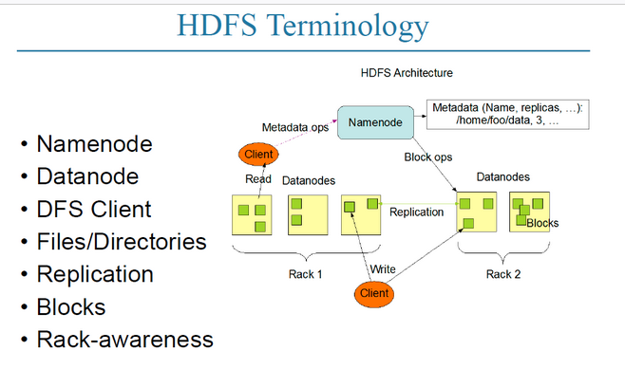

Slide 42
HDFS stores large files (typically in the range of gigabytes to terabytes) across multiple machines.
It achieves reliability by replicating the data across multiple hosts, and hence does not require RAID storage on hosts.
With the default replication value, 3, data is stored on three nodes: two on the same rack, and one on a different rack.
Data nodes can talk to each other to rebalance data, to move copies around, and to keep the replication of data high.

Slide 43
HDFS added the high-availability capabilities for release 2.x, allowing the main metadata server (the NameNode) to be failed over manually to a backup in the event of failure, automatic fail-over.
The HDFS file system includes a so-called secondary namenode, which misleads some people into thinking that when the primary namenode goes offline, the secondary namenode takes over.
In fact, the secondary namenode regularly connects with the primary namenode and builds snapshots of the primary namenode's directory information, which the system then saves to local or remote directories.
These checkpointed images can be used to restart a failed primary namenode without having to replay the entire journal of file-system actions, then to edit the log to create an up-to-date directory structure.
Because the namenode is the single point for storage and management of metadata, it can become a bottleneck for supporting a huge number of files, especially a large number of small files.
HDFS Federation, a new addition, aims to tackle this problem to a certain extent by allowing multiple name-spaces served by separate namenodes.

Slide 44
An advantage of using HDFS is data awareness between the job tracker and task tracker.
The job tracker schedules map or reduce jobs to task trackers with an awareness of the data location.
For example, if node A contains data (x, y, z) and node B contains data (a, b, c), the job tracker schedules node B to perform map or reduce tasks on (a,b,c) and node A would be scheduled to perform map or reduce tasks on (x,y,z).
This reduces the amount of traffic that goes over the network and prevents unnecessary data transfer. When Hadoop is used with other file systems, this advantage is not always available.
This can have a significant impact on job-completion times, which has been demonstrated when running data-intensive jobs. HDFS was designed for mostly immutable files and may not be suitable for systems requiring concurrent write-operations.

Slide 45
Another limitation of HDFS is that it cannot be mounted directly by an existing operating system.
Getting data into and out of the HDFS file system, an action that often needs to be performed before and after executing a job, can be inconvenient.
A filesystem in Userspace (FUSE) virtual file system has been developed to address this problem, at least for Linux and some other Unix systems.
File access can be achieved through the native Java API, the Thrift API, to generate a client in the language of the users' choosing (C++, Java, Python, PHP, Ruby, Erlang, Perl, Haskell, C#, Cocoa, Smalltalk, or OCaml), the command-line interface, or browsed through the HDFS-UI web app over HTTP.

Slide 46
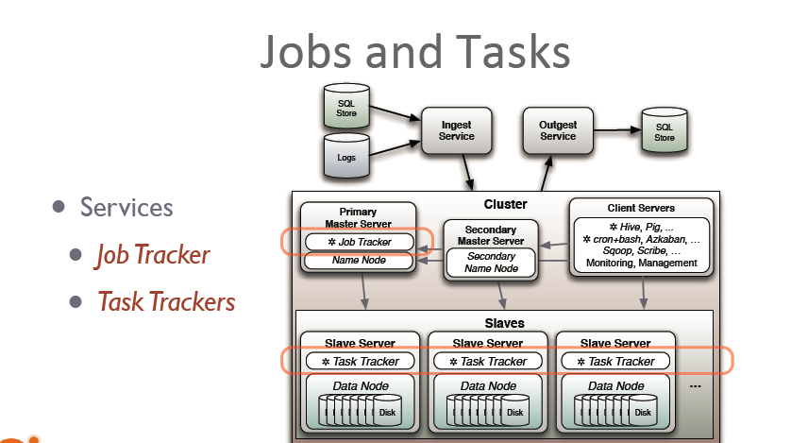
JobTracker and TaskTracker: The MapReduce engine

Slide 47
Above the file systems comes the MapReduce engine, which consists of one JobTracker, to which client applications submit MapReduce jobs.
The JobTracker pushes work out to available TaskTracker nodes in the cluster, striving to keep the work as close to the data as possible.
With a rack-aware file system, the JobTracker knows which node contains the data, and which other machines are nearby.
If the work cannot be hosted on the actual node where the data resides, priority is given to nodes in the same rack.
This reduces network traffic on the main backbone network.
If a TaskTracker fails or times out, that part of the job is rescheduled.
The TaskTracker on each node spawns off a separate Java Virtual Machine process to prevent the TaskTracker itself from failing if the running job crashes the JVM.
A heartbeat is sent from the TaskTracker to the JobTracker every few minutes to check its status. The Job Tracker and TaskTracker status and information is exposed by Jetty and can be viewed from a web browser.

Slide 48
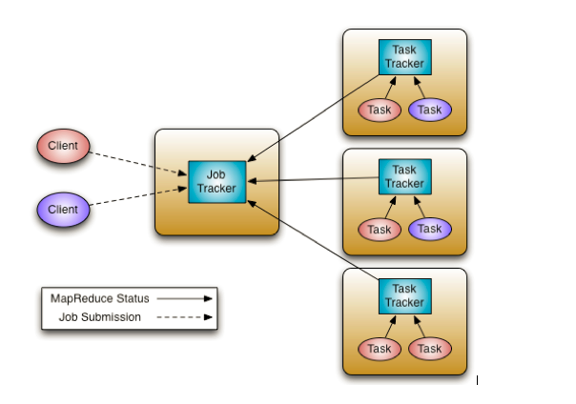

Slide 49
If the JobTracker failed on Hadoop 0.20 or earlier, all ongoing work was lost. Hadoop version 0.21 added some checkpointing to this process.
The JobTracker records what it is up to in the file system.
When a JobTracker starts up, it looks for any such data, so that it can restart work from where it left off.

Slide 50
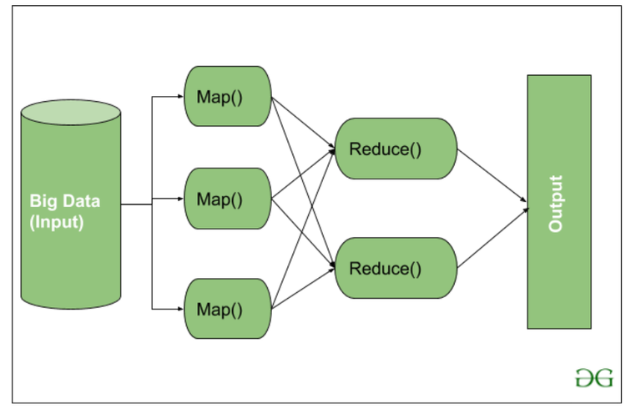

Slide 51
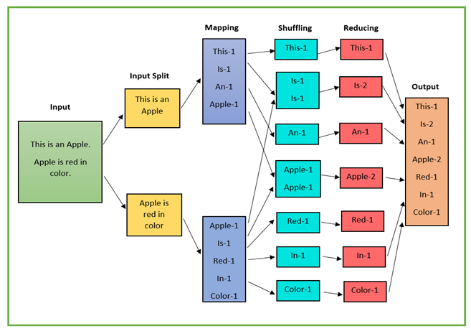

Slide 52
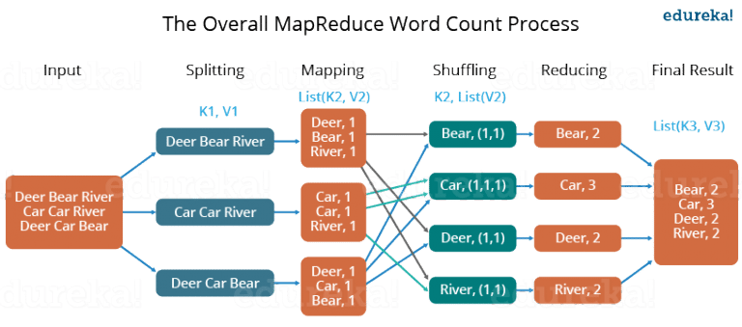

Slide 53
Advantages of Hadoop and MapReduce
Scalability: Hadoop can handle large volumes of data by leveraging the computing power of a cluster of commodity hardware.
Cost-effective: Hadoop is open-source and can run on commodity hardware, making it a cost-effective solution for big data processing.
Fault-tolerant: Hadoop is designed to handle hardware failures by replicating data across multiple nodes in the cluster.
Flexible: MapReduce can be used for a wide range of data processing tasks, including log analysis, data mining, and machine learning.

Slide 54
1.3 Apache Spark

Slide 55
Spark is a unified analytics engine for large-scale data processing including built-in modules for SQL, streaming, machine learning and graph processing.
Apache Spark is an open-source cluster computing framework.
Its primary purpose is to handle the real-time generated data.
Spark was built on the top of the Hadoop MapReduce.
It was optimized to run in memory whereas alternative approaches like Hadoop's MapReduce writes data to and from computer hard drives.
So, Spark process the data much quicker than other alternatives.

Slide 56
History of Spark
The Spark was initiated by Matei Zaharia at UC Berkeley's AMPLab in 2009.
It was open sourced in 2010 under a BSD license.
In 2013, the project was acquired by Apache Software Foundation.
In 2014, the Spark emerged as a Top-Level Apache Project.

Slide 57
Features of Apache Spark
Fast - It provides high performance for both batch and streaming data, using a state-of-the-art DAG scheduler, a query optimizer, and a physical execution engine.
Easy to Use - It facilitates to write the application in Java, Scala, Python, R, and SQL. It also provides more than 80 high-level operators.
Generality - It provides a collection of libraries including SQL and DataFrames, MLlib for machine learning, GraphX, and Spark Streaming.
Lightweight - It is a light unified analytics engine which is used for large scale data processing.
Runs Everywhere - It can easily run on Hadoop, Apache Mesos, Kubernetes, standalone, or in the cloud.

Slide 58
Uses
Data integration: The data generated by systems are not consistent enough to combine for analysis. To fetch consistent data from systems we can use processes like Extract, transform, and load (ETL). Spark is used to reduce the cost and time required for this ETL process.
Stream processing: It is always difficult to handle the real-time generated data such as log files. Spark is capable enough to operate streams of data and refuses potentially fraudulent operations.
Machine learning: Machine learning approaches become more feasible and increasingly accurate due to enhancement in the volume of data. As spark is capable of storing data in memory and can run repeated queries quickly, it makes it easy to work on machine learning algorithms.
Interactive analytics: Spark is able to generate the respond rapidly. So, instead of running pre-defined queries, we can handle the data interactively.

Slide 59
Spark Architecture
The Spark follows the master-slave architecture. Its cluster consists of a single master and multiple slaves.
The Spark architecture depends upon two abstractions:
Resilient Distributed Dataset (RDD)
Directed Acyclic Graph (DAG)
Resilient Distributed Datasets (RDD)
The Resilient Distributed Datasets are the group of data items that can be stored in-memory on worker nodes. Here,
Resilient: Restore the data on failure.
Distributed: Data is distributed among different nodes.
Dataset: Group of data.
Directed Acyclic Graph (DAG)
Directed Acyclic Graph is a finite direct graph that performs a sequence of computations on data. Each node is an RDD partition, and the edge is a transformation on top of data. Here, the graph refers the navigation whereas directed and acyclic refers to how it is done.

Slide 60
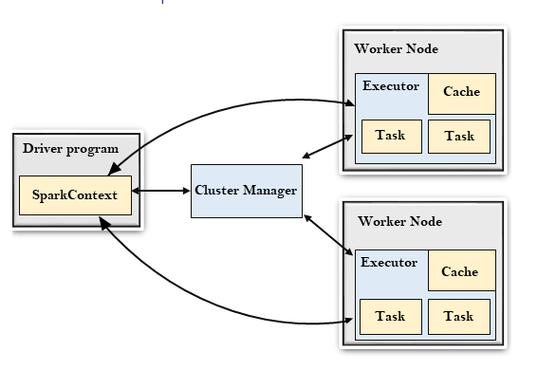

Slide 61
Driver Program
The Driver Program is a process that runs the main() function of the application and creates the SparkContext object. The purpose of SparkContext is to coordinate the spark applications, running as independent sets of processes on a cluster.
To run on a cluster, the SparkContext connects to a different type of cluster managers and then perform the following tasks: -
It acquires executors on nodes in the cluster.
Then, it sends your application code to the executors. Here, the application code can be defined by JAR or Python files passed to the SparkContext.
At last, the SparkContext sends tasks to the executors to run.

Slide 62
Cluster Manager
The role of the cluster manager is to allocate resources across applications. The Spark is capable enough of running on a large number of clusters.
It consists of various types of cluster managers such as Hadoop YARN, Apache Mesos and Standalone Scheduler.
Here, the Standalone Scheduler is a standalone spark cluster manager that facilitates to install Spark on an empty set of machines.

Slide 63
Worker Node
The worker node is a slave node
Its role is to run the application code in the cluster.
Executor
An executor is a process launched for an application on a worker node.
It runs tasks and keeps data in memory or disk storage across them.
It read and write data to the external sources.
Every application contains its executor.
Task
A unit of work that will be sent to one executor.

Slide 64
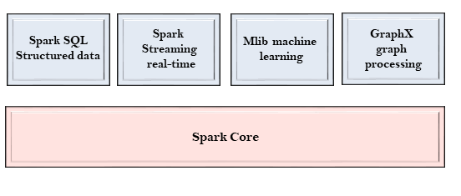
Spark Components
The Spark project consists of different types of tightly integrated components. At its core, Spark is a computational engine that can schedule, distribute and monitor multiple applications.
Let's understand each Spark component in detail.

Slide 65
Spark Core
The Spark Core is the heart of Spark and performs the core functionality.
It holds the components for task scheduling, fault recovery, interacting with storage systems and memory management.
Spark SQL
The Spark SQL is built on the top of Spark Core. It provides support for structured data.
It allows to query the data via SQL (Structured Query Language) as well as the Apache Hive variant of SQL called the HQL (Hive Query Language).
It supports JDBC and ODBC connections that establish a relation between Java objects and existing databases, data warehouses and business intelligence tools.
It also supports various sources of data like Hive tables, Parquet, and JSON.

Slide 66
Spark Streaming
Spark Streaming is a Spark component that supports scalable and fault-tolerant processing of streaming data.
It uses Spark Core's fast scheduling capability to perform streaming analytics.
It accepts data in mini-batches and performs RDD transformations on that data.
Its design ensures that the applications written for streaming data can be reused to analyze batches of historical data with little modification.
The log files generated by web servers can be considered as a real-time example of a data stream.

Slide 67
MLlib
The MLlib is a Machine Learning library that contains various machine learning algorithms.
These include correlations and hypothesis testing, classification and regression, clustering, and principal component analysis.
It is nine times faster than the disk-based implementation used by Apache Mahout.

Slide 68
GraphX
The GraphX is a library that is used to manipulate graphs and perform graph-parallel computations.
It facilitates to create a directed graph with arbitrary properties attached to each vertex and edge.
To manipulate graph, it supports various fundamental operators like subgraph, join Vertices, and aggregate Messages.

Slide 69

1.4 Spark programming (Python and PySpark)

Slide 70
PySpark is a Python API to support Python with Apache Spark.
PySpark provides Py4j library, with the help of this library, Python can be easily integrated with Apache Spark.
PySpark plays an essential role when it needs to work with a vast dataset or analyze them.
This feature of PySpark makes it a very demanding tool among data engineers.

Slide 71
A large amount of data is generated offline and online.
These data contain the hidden patterns, unknown correction, market trends, customer preference and other useful business information.
It is necessary to extract valuable information from the raw data.
We require a more efficient tool to perform different types of operations on the big data.
There are various tools to perform the multiple tasks on the huge dataset but these tools are not so appealing anymore.
It is needed some scalable and flexible tools to crack big data and gain benefit from it.

Slide 72
One of the most amazing tools that helps handle big data is Apache Spark.
As we are familiar that Python is one of the most widely used programming languages among data scientist, data analytics and in various fields.
Because of its simplicity and interactive interface, it is trusted by the data scientist folks to perform data analysis, machine learning and many more tasks on big data using Python.
So, the combination of the Python and Spark would be the very efficient for the world of big data.
That's why Apache Spark Community came up with a tool called PySpark that is a Python API for Apache Spark

Slide 73
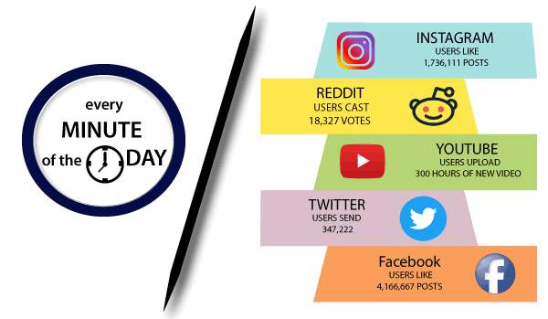

Slide 74
Spark Installation

Slide 75
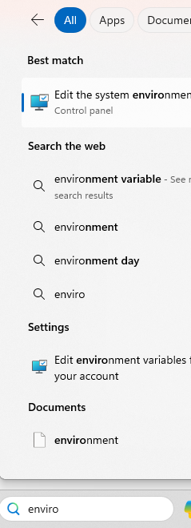
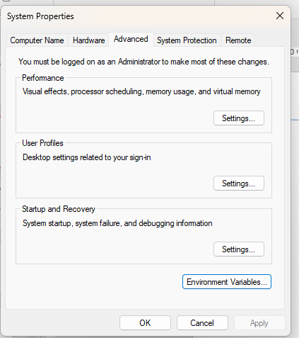
Click This
Click This

Slide 76
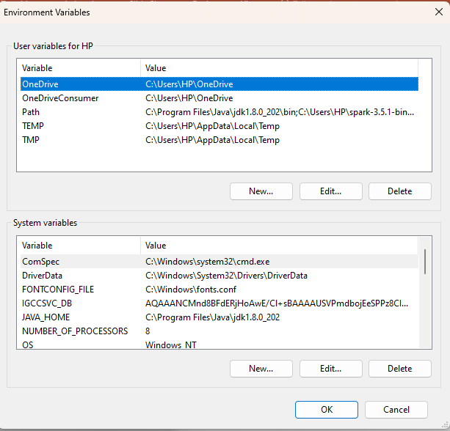
Click here to add Environment Variables

Slide 77
Spark Installation – Set Environment Variable

Slide 78
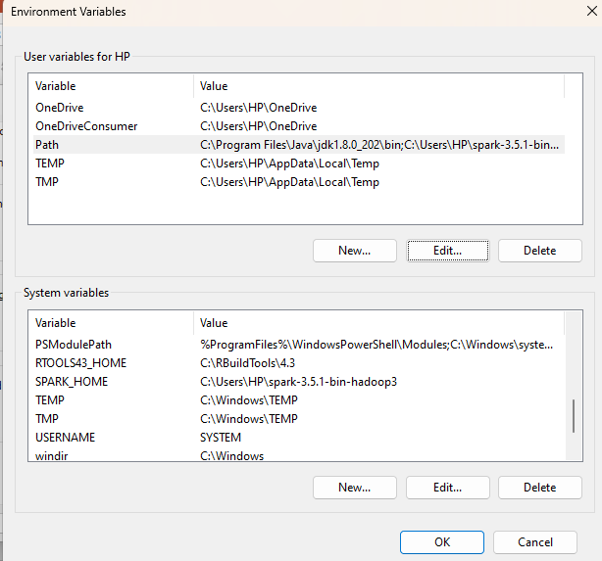

Slide 79
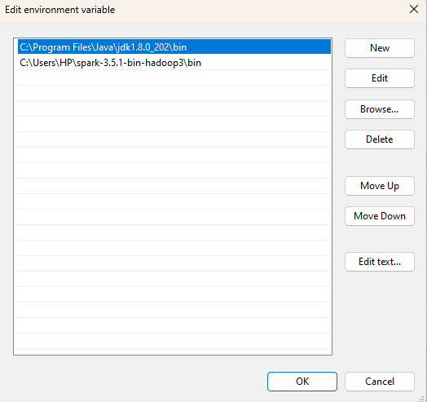

Slide 80
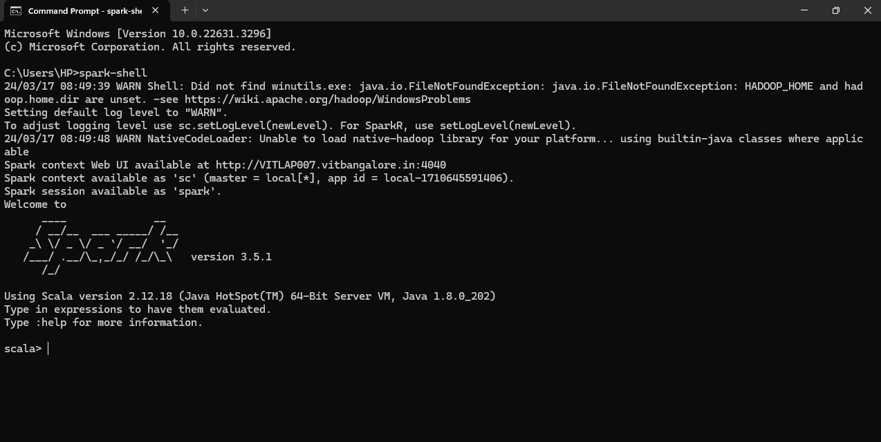

Slide 81
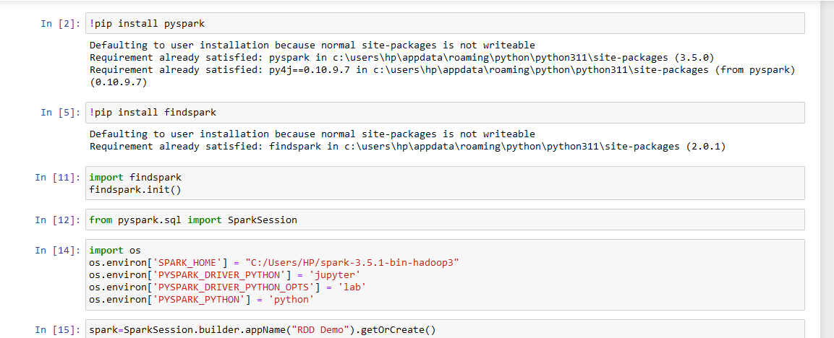

Slide 82
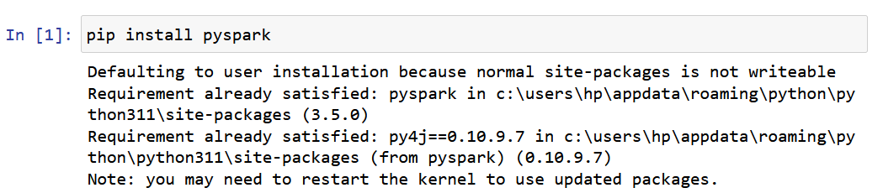
Install pyspark

Slide 83
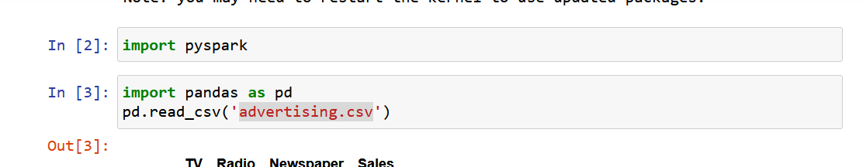

Slide 84
SparkSession
pyspark.sql.SparkSession: It represents the main entry point for DataFrame and SQL functionality.
A spark session can be used to create the Dataset and DataFrame API.
A SparkSession can also be used to create DataFrame, register DataFrame as a table, execute SQL over tables, cache table, and read parquet file.
from pyspark.sql import SparkSession

Slide 85
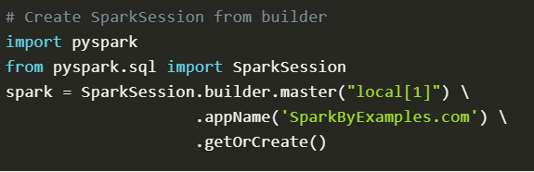

Slide 86
SparkSession.builder()
This method is created for constructing a SparkSession.
master(“local”)
Sets the spark master URL to connect to such as :
“local” to run locally
“local[4]” to run locally with 4 cores
“spark://master:7077” to run on a spark standalone cluster

Slide 87
master() – If you are running it on the cluster you need to use your master name as an argument to master(). usually, it would be either yarn or mesos depends on your cluster setup.
Use local[x] when running in Standalone mode. x should be an integer value and should be greater than 0; this represents how many partitions it should create when using RDD, DataFrame, and Dataset. Ideally, x value should be the number of CPU cores you have.
appName() – Used to set your application name.
getOrCreate() – This returns a SparkSession object if already exists, and creates a new one if not exist.

Slide 88
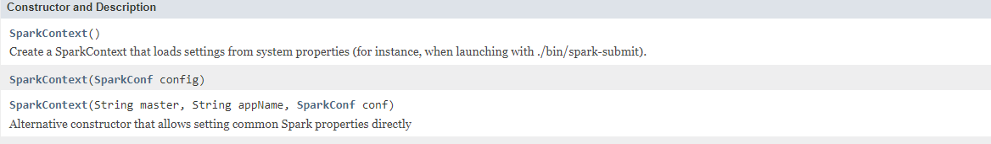
SparkContext
A SparkContext represents the connection to a Spark cluster, and can be used to create RDDs, accumulators and broadcast variables on that cluster.
Only one SparkContext should be active per JVM. You must stop() the active SparkContext before creating a new one.

Slide 89
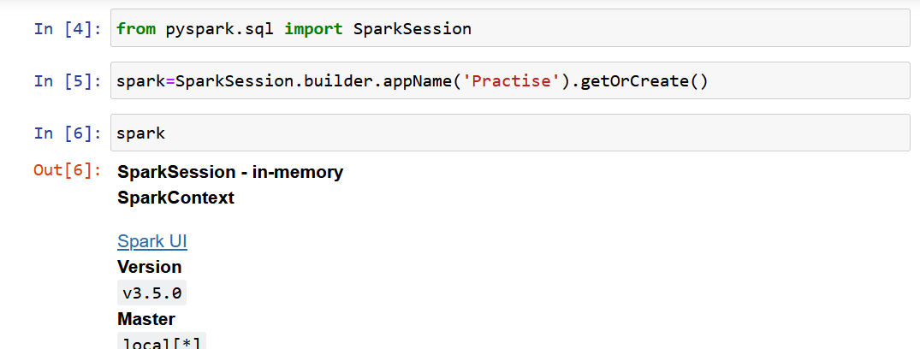
SparkSession – Load .csv file

Slide 90
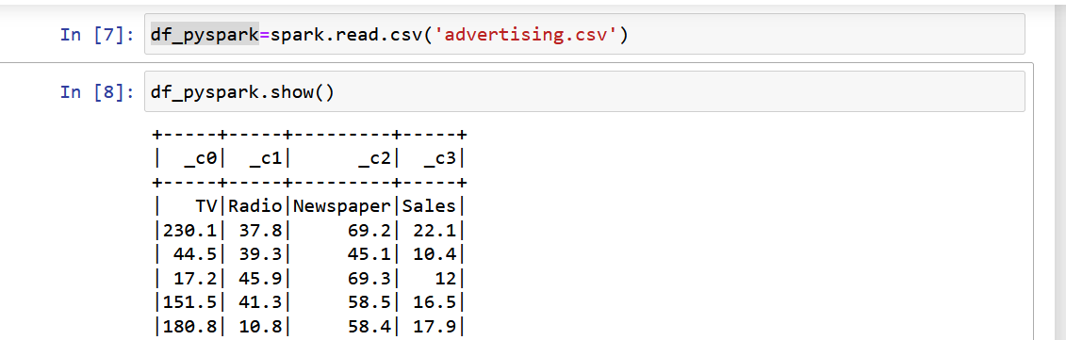

Slide 91
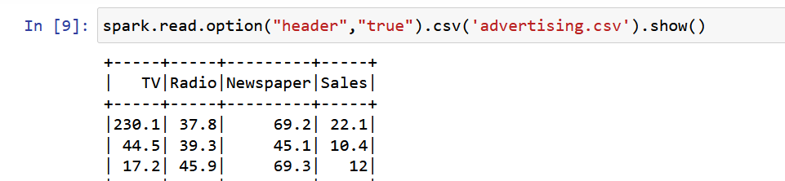

Slide 92
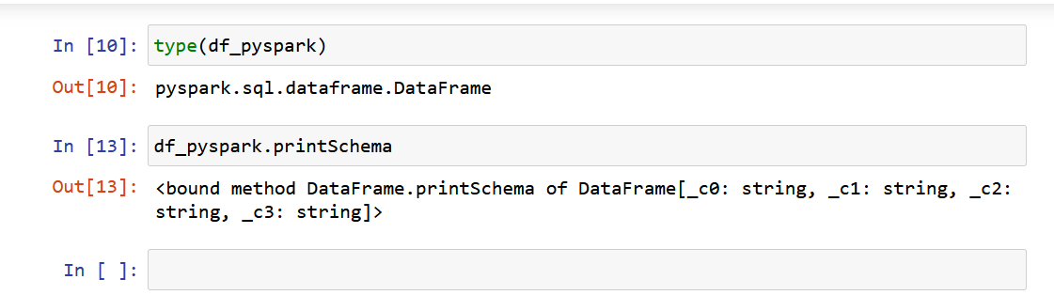
Notes:
https://www.youtube.com/watch?v=WyZmM6K7ubc

Slide 93
1.4 Spark - Resilient Distributed Dataset (RDDs)

Slide 94
What is RDD?
The RDD (Resilient Distributed Dataset) is the Spark's core abstraction.
It is a collection of elements, partitioned across the nodes of the cluster so that we can execute various parallel operations on it.
Parallelizing an existing data in the driver program
Referencing a dataset in an external storage system, such as a shared filesystem, HDFS, HBase, or any data source offering a Hadoop InputFormat.

Slide 95
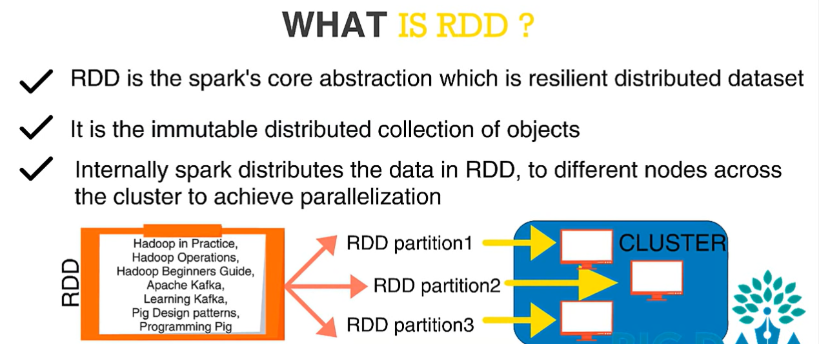

Slide 96
Since RDDs are immutable elements, you cannot alter them after creation.
Because RDDs are fault-tolerant, they will immediately recover from any failure.
These RDDs allow you to do various operations to complete a certain goal.

Slide 97
Features
RDDs enable efficient reuse of intermediate data.
RDDs are fault tolerance because of the Spark distributed architecture.
RDDs are parallel data structures and data chucks are stored on multiple machines.
RDDs allow user-specified data partitioning.
RDDs allow users to cache intermediate results in memory so that they can be reused if needed.

Slide 98
On Spark RDDs we can run two types of data processing operations
Transformation operation and 2. Action operation.
A Transformation operation transforms an RDD into another RDD by applying a function into rows of it.
A data processing pipeline is built by combining a lot of different transformation operations with each other to process the data set.
An Action operation converts an RDD back into not-parallelized value and pulls the data from the distributed cloud into a single machine.
RDD is a collection of data elements that are partitioned across the participating cluster nodes.
It is important to understand that data is distributed across the cluster in data partitions and stored on multiple machines.

Slide 99
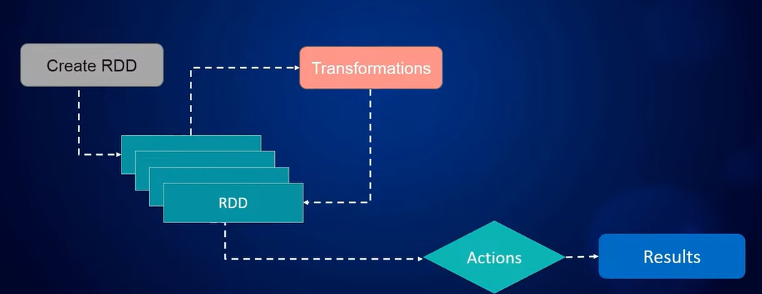

Slide 100
We can import the large input data sets from an input source and create an RDD from it.
We can then transform many times RDDs to each other by using transformation operation and data will still be processed in a large cluster so that we can work with a very large data set.
An action operation pulls the data set from the cloud and moves it back to a single machine.
We run the action operations when we know that the final result will not be very large and can be hold in a single machine main memory.
Note that the action operations cover the object types from Spark distributed objects to the main programing language object type.
As we are using PySpark, action operations will move our code to go back to regular python code, for example we will get a list of objects or single integer number

Slide 101
Instantiations of SparkContext object
from pyspark import SparkContext
sc=SparkContext()

Slide 102
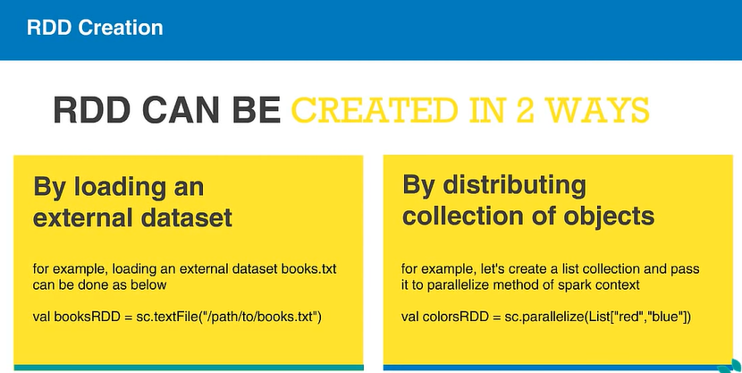

Slide 103
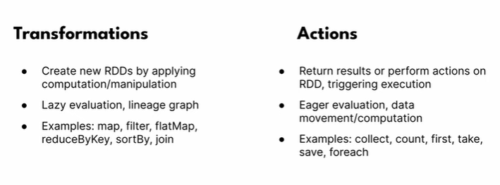

Slide 104
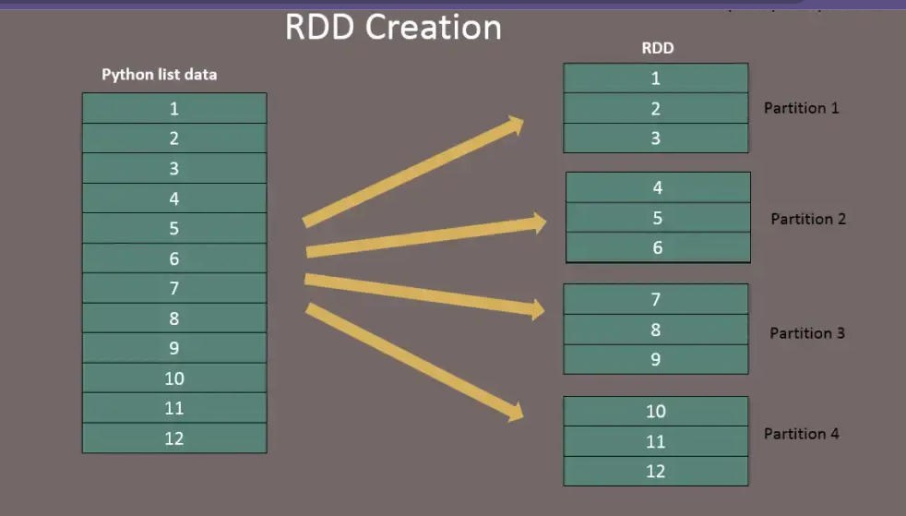
Create RDD

Slide 105
Parallelizing and Collecting the data
parallelize(c, numSlices=None)
The parallelize() function is used to create an RDD from a collection or an iterable object by distributing the data across multiple partitions in a parallel manner.
Parameters:
c: The collection or iterable object to be parallelized into an RDD.
numSlices (optional): The number of partitions to split the data into. By default, it is set to None, and the number of partitions is determined automatically based on the cluster configuration.
Returns: An RDD representing the distributed data.

Slide 106
Note:
The parallelize() function is a method available in PySpark's SparkContext class.
The data in the collection or iterable object is partitioned and distributed across multiple partitions, allowing for parallel computation on a cluster.
The resulting RDD is immutable and can be operated upon using various transformation and action operations available in PySpark.
It is generally recommended to have a sufficient number of partitions to fully utilize the available cluster resources and enable parallel processing.
The parallelize() operation is a transformation operation in PySpark, meaning it is lazily evaluated. It will not be executed until an action is triggered on the resulting RDD.
The parallelize() function is commonly used when working with small to medium-sized datasets that can fit into memory on a single machine.
The parallelize() function provides a convenient way to create an RDD from in-memory data, but for larger datasets, it is often more efficient to read the data from external storage systems using input operations like textFile() or csvFile().

Slide 107
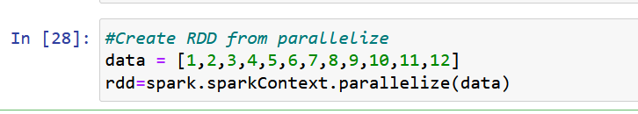

Slide 108
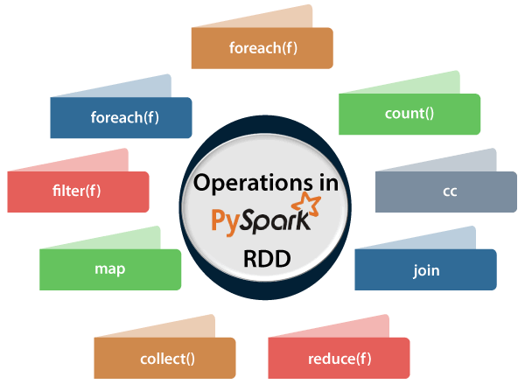

Slide 109
Transformation Operations
Spark provides a set of different RDD transformation operation.

Slide 110
map
flatMap
filter
distinct
reduceByKey
mapPartitions
sortBy

Slide 111
Map Operation
Map converts the content of a single row of an RDD to a new single row of a new RDD by apply a function.
We can define function by using lambda functions or a normal named function.
Note that Map() operation will convert one value to another one value (one row of an RDD to a new row a one-to-one relationship).
We map each value of the RDD is mapped from a single character to a tuple of that character and an integer one

Slide 112
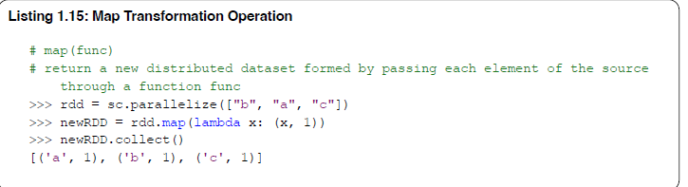

Slide 113
flatMap Operation
flatMap maps each single row of an RDD to many values so we can have a one- to-many relationship between the original RDD and the mapped one after applying a function.
flatMap requires having a function that specifies how a single value (row) of an RDD should be flat-mapped to a list of values and generate many rows of the new RDD.
We have an RDDs of integer and we use Python function ”range(1,x)” to flat-map each integer to many new integers.
In this example we use collect() action operation to print out the results.
Here the result is not extensive list so we can use collect() action to pull the results from the cloud to the

Slide 114
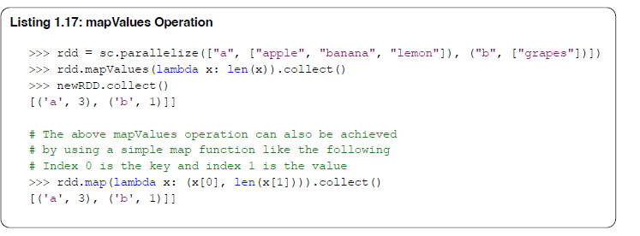
Map Values Operation
We can use mapValues() operation to map values of an RDD and pass each value in the key-value pair of an RDD through a map function without changing the keys.
We can also use a simple map() operation to only mapValues like shown

Slide 115
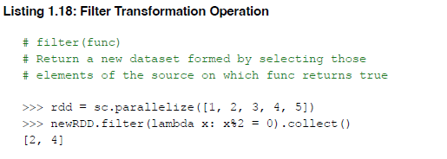
Filter Operation
Filter is an operation to do selection operation similar to relational databases. Listing 1.18 is an example of filter operation, first we generate an RDD that includes numbers 1 to 5 in its rows and we use filter operation to filter out even numbers from the RDD.

Slide 116
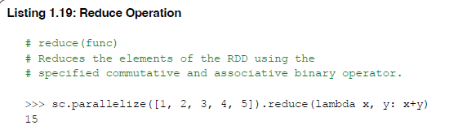
Reduce Operation
Reduce operation can reduce the elements of an RDD using the specified commutative and associative binary operator.
We should define a function to process the reduce operation commutative (given two inputs resulting in one output) and be associative (to reduce the results of the past reduce processes).

Slide 117

Reduce By Key Operation
ReduceByKey operation can reduce the values based on a key and a reduce function that specifies how Spark should run the reduction operation.
Listing 1.20 is an example of reduceByKey operation. We reduce integer values by using the key of tuples (the first element in a tuple is the key).

Slide 118


Slide 119
Create an RDD by reading a txt file

Slide 120
flatMap – flatMap() transformation flattens the RDD after applying the function and returns a new RDD. On the below example, first, it splits each record by space in an RDD and finally flattens it. Resulting RDD consists of a single word on each record.

Slide 121

map – map() transformation is used the apply any complex operations like adding a column, updating a column e.t.c, the output of map transformations would always have the same number of records as input.
In our word count example, we are adding a new column with value 1 for each word, the result of the RDD is PairRDDFunctions which contains key-value pairs, word of type String as Key and 1 of type Int as value.

Slide 122

reduceByKey – reduceByKey() merges the values for each key with the function specified. In our example, it reduces the word string by applying the sum function on value. The result of our RDD contains unique words and their count.

Slide 123

sortByKey – sortByKey() transformation is used to sort RDD elements on key. In our example, first, we convert RDD[(String,Int]) to RDD[(Int, String]) using map transformation and apply sortByKey which ideally does sort on an integer value. And finally, foreach with println statements returns all words in RDD and their count as key-value pair

Slide 124

filter – filter() transformation is used to filter the records in an RDD. In our example we are filtering all words starts with “a”.

Slide 125
Use of PySpark RDD
Spark uses the RDD (Resilient Distributed Dataset) data structure as a foundation to conduct MapReduce operations quickly and effectively.
Replication, serialization, and disc IO all contribute to the lengthy time required for data exchange in MapReduce.
Read-write operations in Hadoop applications use more than 90% of the processing time.
Researchers developed this in-memory processing RDD approach as a result.
Compared to network and disc, using RDDs accelerated data sharing in memory by a factor of 10 to 100.

Slide 126
Word Count Example in PySpark
textFile(name, minPartitions=None, use unicode=True)

Slide 127

Union of two RDDs
Union operation merges two RDDs into one RDD. Listing 1.22 is an example of Union which merges an RDD with itself and the result will be new RDD doubled in size.

Slide 128

Distinct values of an RDD
If rows of an RDD have duplicates, you can use distinct() transformation to remove the duplicates. Listing 1.23 is an example of distinct operation.

Slide 129

Join of two RDDs
Join operation joins two RDDs using their keys. Listing 1.24 is a simple join operation and creates an intersection of the two RDDs. Listing 1.25 is a left outer join considering the operation direction to define left and right side of the two RDDs data sets.

Slide 130


Slide 131


Slide 132


Slide 133
Cartesian Product of two RDDs
RDDs are distributed data structures that can be very huge in data volume distributed over a set of cluster computers.
Considering this, it is not possible to pull the RDD from the cloud and write a for-loop to iterate over it. We would then use Map operations to iterate over the data.
Now, consider that you need to iterate over all combinations of each element/row of the RDD with each other.
In normal case of application programming, if you need to iterate over the combinations of a collection, you would write two for-loops and then iterate over them.
In large scale data processing this is not possible, instead of two for-loops, we use Cartesian Product to generate all combinations first and then process it with a subsequent Map operation. List 1.28 illustrates an example of a Cartesian product of an RDD with itself.

Slide 134


Slide 135
GroupByKey Operation
When groupbyKey is called on an RDD of (K, V) pairs, it returns an RDD dataset of (K, Seq[V]) pairs.
GroupByKey operation forces Spark to shuffle the data with same key to be pushed to the same node and can cause bottlenecks if datasets includes very large amounts of objects with the same key.
Listing 1.29 provides an example of groupByKey operation on an RDD.
The result of groupByKey is an Spark internal iteratable object that includes data collection.
As shown in Listing 1.29, show the content of groupByKey operation we convert it to simple python list objects, collect and sort it for pretty printing.

Slide 136



Slide 137
In our Spark implementation, we should not use "groupByKey" when the result of grouping can be large and
cause a bottleneck in our cluster. Instead, it is preferred to use "reduceByKey" over "groupByKey" because
"reduceByKey" operation does not force shuffle and it can reduce the dataset in a distributed setting

Slide 138

SortByKey Operation
SortByKey operation can be used on an RDD of (KEY, VALUE) pairs to sort the RDD based on the keys.
The operation returns an RDD of the same type of (KEY, VALUE) pairs sorted by keys in ascending or descending order, as specified in the boolean ascending argument.

Slide 139
Aggregate by key Operation
Sometimes we need to pass over the dataset and run aggregation operation by using a key similar to the reduceByKey operation.
AggregateByKey operation can run aggregation of data items into a final result collection
like a list.
For example, consider that you have dataset about customers of a shop and their orders, and your goal is to collect a list of customers and a list of products that each of the customers bought from the shop. You would need to pass over the data and collect the products that each customer ordered.

Slide 140
Aggregate by key Operation
An aggregateByKey operation requires the following 3 argument specifications to run the aggregation:
1. Zero Value. The “zero” value to initialize the aggregation. This should for example define how to initialize a
collection like a list or set.
2. Sequence Function. Lambda that takes x1, x2 and aggs them, where x1 already aggregated, x2 is not. For
example, this argument defines how to add one element to a list.
3. Combiner Function. Lambda that takes x1, x2 and aggs them, where both already aggregated. For example, this argument should define how to merge two lists into one list.

Slide 141


Slide 142

Tree Aggregate Operation

Slide 143
Zip Operation
Zip operation zips an RDD with another one so that you will get a new RDD with a first element in from the first RDD and second element from the second.
Zip operation considers that the two RDDs have the same number of partitions and the same number of elements in each partition so it can run the zip process. Listing 1.32 is an example of this operation.

Slide 144


Slide 145
Zip with Index Operation
Zips an RDD with its element indices.
This is a very useful operation when we need to give elements in an RDD specific index numbers so that we can process some of them based on the index numbers in a subsequent processing step.
The ordering is first based on the partition index and then the ordering of items within each partition.
So the first item in the first partition gets index 0, and the last item in the last partition receives the largest index. This method needs to trigger a spark job when this RDD contains more than one partition.

Slide 146


Slide 147
Partitions and Partitioning Operation
As described, RDD is a collection of data elements partitioned across the cluster nodes so that Spark uses multiple processes in parallel to process the massive data set.
1.8.21. Glom Operation
Glom operation returns an RDD created by coalescing all elements within each partition into a list. Glom is a highly useful operation when you want to access batches of an RDD. Listing 1.34 is a simple example of how we can access data batches of an RDD.

Slide 148


Slide 149
Repartition Operation
It returns an RDD that has precisely the number of data partitions requested. Repartition can increase or decrease the level of parallelism in this RDD.
Internally, this shuffles the data to redistribute it.
If you are decreasing the number of partitions in this RDD, consider using coalesce operation, which can avoid performing a data shuffle operation.

Slide 150


Slide 151
Coalesce Operation
Coalesce is doing repartitioning, but you can avoid data shuffling around the cluster. It returns a new RDD with the reduced number of data partitions.

Slide 152


Slide 153
Cache Operation
When we want to reuse an intermediate RDD in a subsequent processing step multiple time, Cache operation are useful to keep the intermediate RDD in the main memory of the cluster machines.
Listing 1.37 is a simple example of this operation.
We normally use Cache operation after we clean up the raw data set and are ready for any subsequent process, e.g., learning a data model or testing a data model. If we do not cache the intermediate RDD data, the Spark process will restart to generate the intermediate data again and again from the original raw data set, on each code line that we want to use the intermediate RDD. examples of reusing intermediate RDDs when we work on large-scale machine learning data pipeline.
Cache operation has many usage forms, you can cache data in main memory or on disk of your cluster machines.
It is important to know that you cluster need to have enough memory space to cache the data. We should cache
RDDs when we really need them again in subsequent processing steps. An overuse of Cache operation can use an enormous size of cluster memory which may cause out of memory errors, or make the process very inefficient and slow.

Slide 154


Slide 155

Actions in Pair RDDs
Although Pair RDDs can be used for any RDD Action, a few articles are tailored exclusively for Pair RDDs.
These actions should only be used with Pair RDDs and will not function on regular RDDs.
The actions that are frequently used for Key-Value type Pair RDD data are mentioned below.
The country key() Action
The number of values linked with each key in the provided data is counted using the.countByKey() action. This operation returns a dictionary, which can be iterated using loops to retrieve the keys and values. We can also utilize dictionary methods like.keys(),.values(), and.items because the result is a dictionary ().

Slide 156
collect
collectAsMap
reduce
countByKey/countByValue
take
first

Slide 157

count() – Returns the number of records in an RDD

Slide 158


first() – Returns the first record.
max() – Returns max record.

Slide 159


reduce() – Reduces the records to single, we can use this to count or sum.
take() – Returns the record specified as an argument.

Slide 160


collect() – Returns all data from RDD as an array. Be careful when you use this action when you are working with huge RDD with millions and billions of data as you may run out of memory on the driver.
saveAsTextFile() – Using saveAsTestFile action, we can write the RDD to a text file.

Slide 161
Save Data on Distributed File Systems
Spark provides action operations to store large scale result files. As we described before the Spark system is a multi-threaded and multi-process system. Each Spark process would need its output.
Save as Text File
By using saveAsTextFile operation, we can store an RDD into text files. This operation requires a path to store text files. Path can be the local file system path like your local computer file system, starting with "file:///" or it can he a distributed file system that can be addressed in different ways, like storage of files in HDFS files would need a
path file that starts with "hdfs://ADDRESS/", or storage in Amazon AWS S3 storage would be a path that starts with "s3://ADDRESS/", or google cloud storage system with "gs://ADDRESS/".
The path for folders should exist on the file system. In some special cases like AWS S3, the main folder named bucket should exist, but the exact sub-folder should not exist and the operation will create it. Spark stores the final results in multiple files depending on the number of partitions of your RDD. If your final RDD is relatively small and you want to store it in a single file, then you can re-partition it into a single partition (e.g., using coalesce operation) and then use saveAsTextFile() operation

Slide 162
Save as Binary Sequence File
Spark provides another operation to store results in binary format using saveAsSequenceFile(PATH).
A sequence file is file that can be read by parallel processes.
It is also possible to compress the result before storage.
The exact binary format of the file is from type of Java org.apache.hadoop.io.Writable.

Slide 163
Lazy Evaluations
Spark uses a technique called ”Lazy Evaluation”, which means when an execution of a data processing is not needed, Spark will not run it.
The data processing will only start when the result of the processing is required.
For example, the code in Listing 1.46 will not trigger any data processing because the result of it is not requested by the code. It will only be requested and start running when, for example, there is an action operation like collect(), count(), top(), or any others.

Slide 164


Slide 165
Objective
Your task is to use PySpark RDD operations to analyze the dataset and answer the following questions:
Load the data into an RDD and remove the header
Count the number of songs
Count the number of songs by each artist
Get the distribution of songs by release year

Slide 166


Slide 167


Slide 168


